Slide 1
Machine Translation Using Neural Network
Made By
Kaushal Thakkar (15BCE125)
Shaival Shah (15BCE110)
Guide
Dr. Priyank B. Thakkar

Slide 2
Word Embedding
Machine Learning algorithms and almost all Deep Learning Architectures are incapable of processing strings or plain text in their raw form.
They require numbers as inputs to perform any sort of job, be it classification, regression etc. in broad terms.
A Word Embedding format generally tries to map a word using a dictionary to a vector.
A vector representation of a word may be a one-hot encoded vector where 1 stands for the position where the word exists and 0 everywhere else. The vector representation of “numbers” in this format according to the above dictionary is [0,0,0,0,0,1] and of converted is[0,0,0,1,0,0].

Slide 3
Types of Word Embedding
Frequency Based Embedding
Prediction based Embedding
1
2

Slide 4
Frequency Based Embedding
Count Vector
TF-IDF

Slide 5

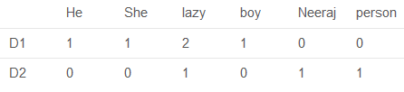
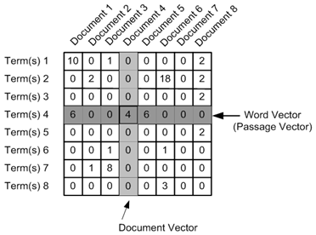
Count Vector

Slide 6
TF-IDF
This is another method which is based on the frequency method but it is different to the count vectorization in the sense that it takes into account not just the occurrence of a word in a single document but in the entire corpus.
Ideally, what we would want is to down weight the common words occurring in almost all documents and give more importance to words that appear in a subset of documents.
TF-IDF works by penalizing these common words by assigning them lower weights while giving importance to words like Messi in a particular document.
TF = (Number of times term t appears in a document)/(Number of terms in the document)
IDF = log(N/n)
TF-IDF = TF*IDF
If the value of TF-IDF is very less then we can say that that word is not very important in the corpus.

Slide 7
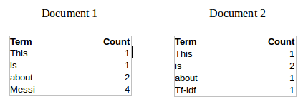
Continue
TF(This,Document1) = 1/8
TF(This, Document2)=1/5
IDF = log(N/n)
IDF(This) = log(2/2) = 0
IDF(Messi) = log(2/1) = 0.301.
TF-IDF(This,Document1) = (1/8) * (0) = 0
TF-IDF(This, Document2) = (1/5) * (0) = 0
TF-IDF(Messi, Document1) = (4/8)*0.301 = 0.15

Slide 8
Prediction based vector
Skip – Gram Model
Continuous Bag of Words

Slide 9
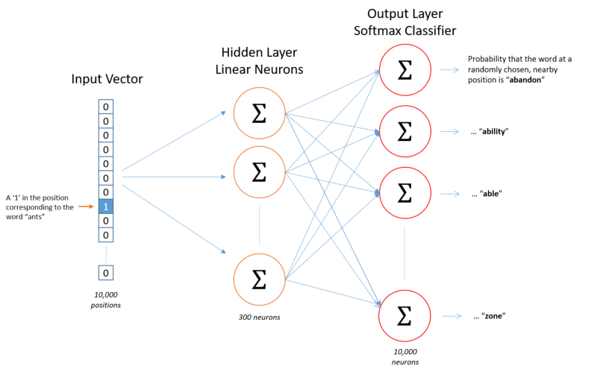
Skip – Gram Model
The aim of skip-gram is to predict the context given a word.

Slide 10
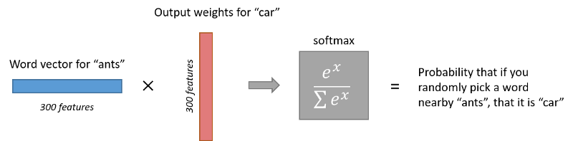
We need few additional modifications to the basic skip-gram model which are important for actually making it feasible to train. Running gradient descent on a neural network that large is going to be slow. And to make matters worse, you need a huge amount of training data in order to tune that many weights and avoid over-fitting. millions of weights times billions of training samples means that training this model is going to be a beast.
There are three innovations in this second paper:
1) Treating common word pairs or phrases as single “words” in their model
2) Subsampling frequent words to decrease the number of training examples
3) Use negative sampling

Slide 11
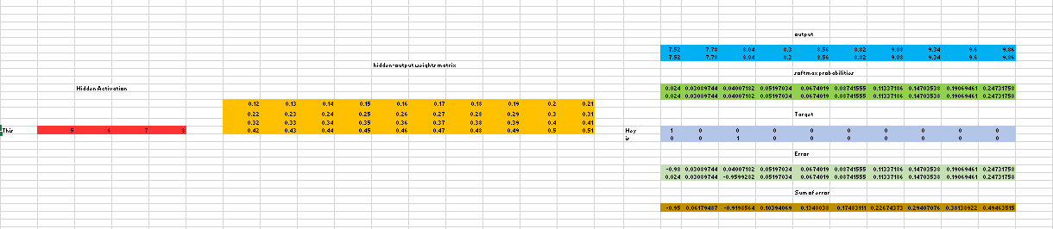

Slide 12
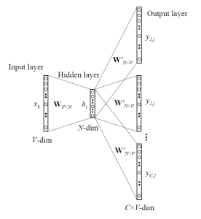

Slide 13
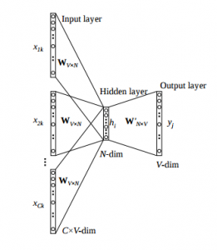
Continuous Bag of Words
It is the opposite of the Skip – Gram Model.
In this we will predict the target word using given context word.

Slide 14
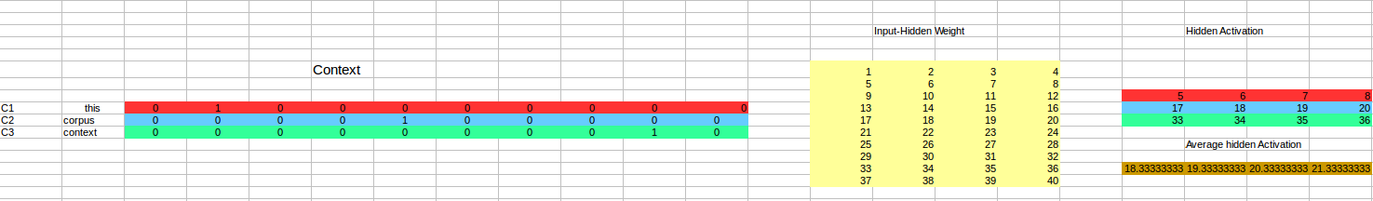

Slide 15
Long Short Term Memory
Long short term memory is variant of Recurrent Neural Network.
Basically the job of LSTM is to hold long term dependencies which is necessary for longer sequences to train.
LSTM consist of forget gate which is useful in memorizing useful content and forget which is not useful.
LSTM also solves the vanishing gradient and exploding gradient problem of RNN.
LSTM has forget gate which activation is always close to 1. The effective weight of the recurrence is equal to the forget gate activation. This gives advantage to LSTM to solve that problem of both vanishing and exploding gradient.

Slide 16
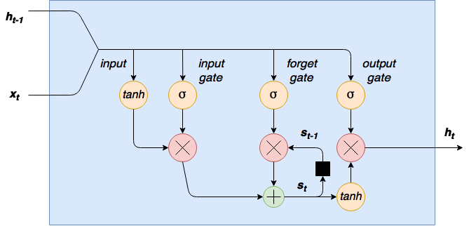
Architecture of LSTM Cell

